Slide 1


SECURE SOFTWARE DEVELOPMENT (SSD)
Diploma in CSF
Academic Year (AY) 22/23 – Semester 3 (April `22)
Week 1
Module overview
Last Updated: 1/04/2022

Slide 2
Contents
Online Tool: Microsoft Teams
Teaching & Learning Approach: Experiential Learning
Development Tool: SSD VM Image
Module Synopsis & Aims
Ground Rules | Teaching Team
Module Assessments

Slide 3
Module Synopsis
Most of the current cyber attacks could be prevented by adopting secure software development practices.
This module provides students with the knowledge of
Secure software development lifecycle
Incorporating security throughout the entire process of software development
Designing, coding, testing and deploying software with a security mindset
Above is the secure software development lifecycle. Keyword is Secure Software (word)
This module trains students on
Identifying, gathering and recording security requirements for a software
Various security frameworks, considerations and methodologies
Software vulnerabilities and how to address their risks
Write secure code that is resilient against critical web application attacks
Secure software testing

Slide 4
Aims of the Module
To develop the understanding of secure software development lifecycle;
To develop the understanding of software vulnerabilities and their risks;
To develop the practical skills in secure software requirements gathering;
To develop the practical skills in secure software design;
To develop the practical skills in secure software coding;
To develop the practical skills in secure software testing and deployment.

Slide 5
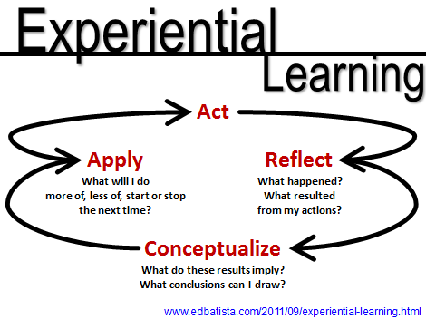
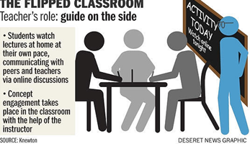


Teaching & Learning Approaches
Experiential Learning Slide 6 | Flipped Classroom Slide 7
No Spoon-feeding Slide 8 | Remote Learning Slide 9

Slide 6
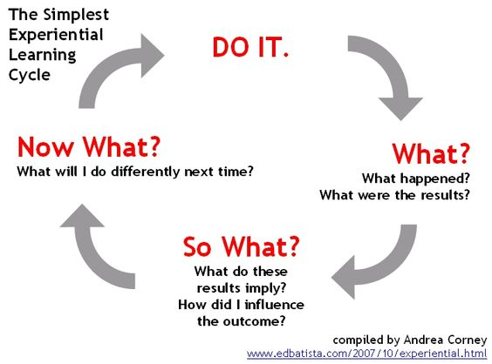
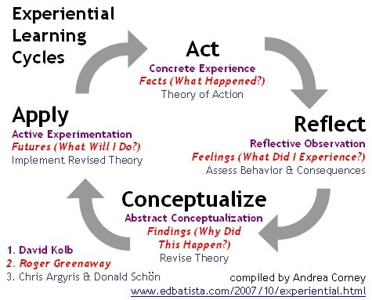
Teaching & Learning Approach: Experiential Learning
Experiential learning is inductive, learner -centered, and activity oriented.
Personalized reflection about the activity or experience and the formulation of plans to apply learning to other contexts are critical factors in effective experiential learning.

Slide 7
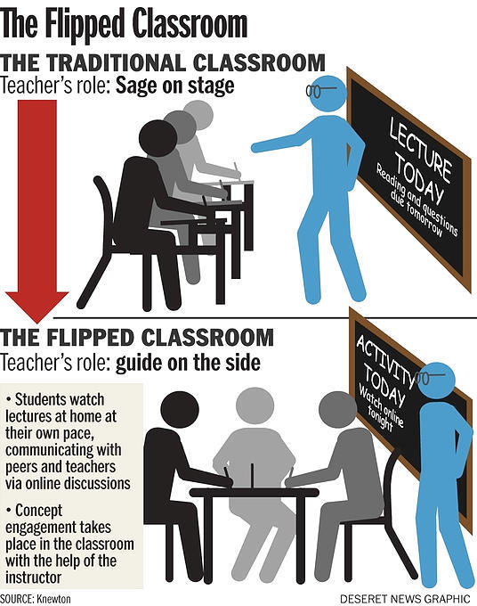
Teaching & Learning Approach: Flipped Classroom
Students learn content that are traditionally delivered in class, outside class, typically online and on a self-directed mode, prior to lesson time.
Sometimes the online learning include online discussions.
When students attend class, time would be devoted to more active learning activities, and deeper learning of the content learnt outside of the classroom.

Slide 8
Teaching & Learning Approach: No Spoon-feeding
Spoon feeding in the long run teaches us nothing but the shape of the spoon. - E. M. Forster
Spoon-feeding culture that inhibits critical thinking in students. https://smiletutor.sg/how-spoon-feeding-is-harmful-to-learning/

Slide 9
Teaching & Learning Approach: Remote Learning
Some lessons will be remote learning (online learning). This means you will do self-directed learning. As such, you do not have to be physically present in campus for SSD class.
The SSD learning materials, would be made available in MEL. MEL will be the landing page to your other learning materials as well, if any.
Do be positive about remote learning as it will develop a life-long independent learners in you, who are able to manage their own time and learning.
Read Why Remote Learning?

Slide 10
Every lesson has 5 Components
There are 2 sessions each week for SSD.
Each session is 2 hours.
One session is for lecture/tutorial.
The other session is for practical/assignment.
Each lesson hopes to inculcate skills in learner whereby learner can thereafter, acquire knowledge.
Learner is also able to participate in mission (activity) to reflect (think) about the concepts taught.
Learner also has the opportunity to feedback on lessons delivered.
Skill
Knowledge
Thinking
Activity
Feedback
2 hr Lecture Lesson
2 hr Practical Lesson

Slide 11

Online Tool
Microsoft Teams
Experiential Learning
Flipped Classroom
Microsoft Teams
1. How to Download and Install Teams Desktop Client
https://www.youtube.com/watch?v=3BQ-M9z8nSM
2. Introduction to Microsoft Teams Series
https://www.youtube.com/watch?v=ssBG4mSjJJ8
https://www.youtube.com/watch?v=Q7Az0PAjif8
https://www.youtube.com/watch?v=2qtGOZQ0sGg

Slide 12
Module Assessments
Assessment Type | Percentage
Continual Assessment (CA) | 10%
Practical Test | 20%
Common Test | 30%
Group Assignment | 40%
Total Percentage | 100%

Slide 13

Ground Rules
Regardless of Face-to-Face (F2F) or Remote Learning (RL) lessons, please observe the following ground rules in SSD.
Please be reminded that flouting the ground rules may result in deduction of points from Continual Assessment (CA).

Slide 14
Teaching Team
Student group: P02
Email: Divyan_KONIDALA@np.edu.sg
Divyan M. Konidala (Dr)
Mr Mohd Saifulamri Omar (Module Leader)
Student groups: P01, P03
Email: Mohamed_Saifulamri_OMAR@np.edu.sg

Slide 15
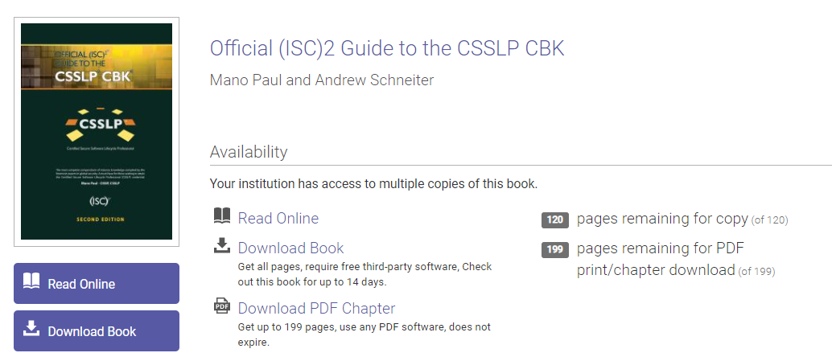
References
ASP.Net Tutorials
https://docs.microsoft.com/en-us/aspnet/core/tutorials/razor-pages/
Focusing on Razor Pages (MVVM)
Official (ISC)² Guide To The CSSLP CBK - Second Edition – by Mano Paul
CSSLP – Certified Secure Software Lifecycle Professional
CBK – Common Body of Knowledge
NP Library: https://bit.ly/3miQoQC
(Login with NP account)

Slide 16
Activity: Microsoft Teams
Install Microsoft Teams as per video shown in slide 11
Please use your NP student account information to log in Teams
Ensure you can see the following Team groups upon successful installation and login:-
SSD-AY2223-xxx-Pxx
where xxx refers to your tutor name
Pxx refers to your class group in SSD
Form team of minimum 3 to a maximum 4 members.
Team Name:
Team Members: Name and NP email
( You can use Team’s conversation to communicate/coordinate team formation)

Slide 17
Activity: Microsoft Teams
The groups formed are meant as follow:
SSD-AY2223-xxx-Pxx
Discuss among group members
Write Wikis
Private channel - Team Name (Tutor will explain)
Discuss among team members
Write Wikis
Write individual reflections
Explanation

Slide 18
Activity: Development Tools
Download VirtualBox and SSD VM Image
VirtualBox 6.0
Download and install from (www.virtualboxorg) - Refer to this website - https://www.youtube.com/watch?v=63_kPIQUPp8
VM Image (Visual Studio 2019 + Tools) – SSD-AY2122-Wtools zipped files
https://bit.ly/3rQhPCK Total Size: 28GB Download zipped SSD VM image from link above. Extract the zipped SSD VM image into local notebook/laptop. SSD VM images contain Visual Studio IDE, BurpSuite, XAMMP and many others. *Students may opt to use Visual Studio IDE in own laptop/notebook. However, support is only given to Visual Studio in VM image.

Slide 19
Mission 1.1: Run SSD VM image in VirtualBox in laptop/notebook (Optional)
Extract zipped SSD VM Image if you have not done so.
Double click on SSD-AY2122-WTools.vbox to open (add) the SSD VM into VirtualBox.
Refer to appended guide to troubleshoot issues on VirtualBox in notebook/laptop.
Screenshot the added SSD VM in VirtualBox and show your tutor.
Password: sstudent
Use Teams conversation to discuss with friends or tutor, if assistance is needed.
Expected completion: End of Week 1

Slide 20
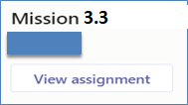
Mission 3.3: Your First Razor Pages Application (Individual)
Please note that Razor Pages mission (Week 1-3) is intentionally released early. The intent is to help you pace learning on Razor Pages.
Visit https://docs.microsoft.com/en-us/aspnet/core/tutorials/razor-pages/
Attempt the following topics:-
Create a Razor Pages web app
Add a model to a Razor Pages app in ASP.NET Core
Scaffolded Razor Pages in ASP.NET Core
Work with a database and ASP.NET Core
Update the generated pages in an ASP.NET Core app
Use .NET Core 3.1 (Long-term support) framework.
Collate detailed screenshots of each of the completed topic in a word document and submit in Brightspace (Week 3).
The screenshots must show the browser’s “Address Bar” to verify the application is running in your laptop.
Submit in General → Assignment (Mission 3.3 Razor Pages Intro)
Deadline: Submit at end of Week 3

Slide 21
Summary
This module provides students with the knowledge of Secure software development lifecycle.
Incorporating security throughout the entire process of software development.
Teaching & Learning Approach
Experiential learning
Flipped Classroom
Module Assessments
CA: 10%
Practical Test: 20%
Common Test: 30%
Group Assignment: 40%
Brightspace / Microsoft Teams

